Slide 1
Guideline Updates in Diabetes: Hypertension
The New Guideline from Korean Diabetes Association 2019
Sang Yong Kim
Division of Endocrinology and Metabolism,
School of Medicine, Chosun University
Notes:
Thanks for your kind introduction
I’m glad to be here and happy to have an opportunity to introduce the new guideline for diabetes in Korea.

Slide 2

Conflict of interest disclosure
None
Committee of Scientific Affairs
Committee of Scientific Affairs
Notes:
This is my disclosure

Slide 3
Notes:
Other speakers introduced this new treatment guideline
So, I will talk about hypertension management in diabetic patients

Slide 4
Hypertension Management in Diabetic Patients
1. Measuring blood pressure is recommended at each visit. [B, I]
2. Lifestyle modification in order to achieve normal blood pressure is recommended for diabetic patients with blood pressure >120/80 mmHg. [B, I]
3. Recommended active lifestyle management includes exercise and diet management; reduction in sodium intake, increase in potassium intake, minimized alcohol intake and increasing exercise. [B, I]
4. The target systolic blood pressure in diabetic patients is recommended <140 mmHg. [A, I]
5. The target diastolic blood pressure in diabetic patients is recommended <85 mmHg. [A, I]
6. The target blood pressure for diabetic patients with cardiovascular disease should be considered <130/80 mmHg. [C, IIa]
Notes:
The following is the contents for hypertension management in diabetes.

Slide 5
Hypertension Management in Diabetic Patients
7. All antihypertensive agents are recommended as first-line therapy for diabetic patients with hypertension. [A, I]
8. ACE inhibitor or ARB is recommended in presence of albuminuria. [B, I]
9. If first-line therapy is inadequate in controlling blood pressure, combination therapy with drugs of different classes is recommended. The combination of ACE inhibitor and ARB is not recommended. [A, I]
10. If blood pressure exceeds 160/100 mmHg, combination therapy with two or more drugs may be considered with active lifestyle modification. [C, IIb]
Notes:
And in a treatment section,

Slide 6
Hypertension Management in Diabetic Patients
1. Measuring blood pressure is recommended at each visit. [B, I]
2. Lifestyle modification in order to achieve normal blood pressure is recommended for diabetic patients with blood pressure >120/80 mmHg. [B, I]
3. Recommended active lifestyle management includes exercise and diet management; reduction in sodium intake, increase in potassium intake, minimized alcohol intake and increasing exercise. [B, I]
4. The target systolic blood pressure in diabetic patients is recommended <140 mmHg. [A, I]
5. The target diastolic blood pressure in diabetic patients is recommended <85 mmHg. [A, I]
6. The target blood pressure for diabetic patients with cardiovascular disease should be considered <130/80 mmHg. [C, IIa]
Notes:
Compared to previous version, overall contents are almost the same.
But the most important change is target blood pressure goal for diabetic patients with hypertension
Today, I would like to focus mainly on this treatment target change and skip the rest due to limitation of time.

Slide 7

Hypertension in diabetic patients
Position in model | CAD |  | Fatal or non-fatal MI
 | Variable | p-value | Variable | p-value
1 | LDL-C | <0.001 | LDL-C | 0.0022
2 | HDL-C | 0.001 | Diastolic BP | 0.0074
3 | HbA1c | 0.002 | Smoking | 0.0025
4 | Systolic BP | 0.0065 | HDL-C | 0.026
5 | Smoking | 0.056 | HbA1c | 0.053
UKPDS 23 : 2,693 white patients with T2DM
Stepwise multivariate Cox models
UKPDS Group. BMJ 1998;316:823-8
Notes:
Hypertension is very common comorbidity in patients with diabetes,
In this Korean diabetes Fact sheets data, we can see the prevalence of hypertension is more than 50% in Korean diabetic patients.
Furthermore, hypertension is a strong risk factor for atherosclerotic cardiovascular disease.
So, management of hypertension is also very important to many diabetic patients.
However, there is a still debate ongoing about the target blood pressure in diabetic patients.

Slide 8
Traditional BP target for diabetes
154
144
87
82
UKPDS 38: 1148 hypertensive patients with type 2 diabetes were allocated to comparing tight control of BP aiming at a < 150/85 mm Hg (with the use of captopril or atenolol) with less tight control aiming at a < 180/105 mm Hg.
BMJ 317:703–713;1998
Notes:
So, what is the appropriate BP target in diabetic patients?
For many years it was common practice to aim for BP targets less than 130/80 mmHg in diabetic patients.
This is the UKPDS trial, about 1000 hypertensive patients with type 2 diabetes were allocated to comparing tight BP control and less tight BP control.
However, BP target in intensive treatment group was less than 150/85 mmHg, and achieved BP in intensive group was 144/82 mmHg in this trial.
So, these ranges of target or attained blood pressure are far apart from current BP target
Nevertheless, intensive control group showed a better outcomes in various clinical endpoints.

Slide 9
History of BP target change in diabetes
Nat Rev Endocrinol. 2017 [Epub ahead of print]
Notes:
Although background evidences are insufficient, blood pressure target lower than standard had become more prevalent in 1990’.
This trend toward ’the lower the better’ was generally recognized in diabetic patients compared to common hypertension Pts.
In this table, we can see the many guidelines before 2010’ recommending a BP target lower than 130/80 mmHg in diabetes,
After 2010’ we can see that the target of systolic blood pressure was changed to 140 mmHg.
Why did this target blood pressure changes occur?

Slide 10
Objection for the traditional target of SBP – ACCORD trial
133.5/70.5
119.3/64.4
A total of 4733 participants with type 2 diabetes were randomly assigned to intensive therapy, targeting a SBP of less than 120 mm Hg, or standard therapy, targeting a SBP of less than 140 mm Hg. The mean follow-up was 4.7 years.
N Engl J Med 362:1575–1585;2010
Notes:
This is the ACCORD BP trial.
More than 4000 diabetic patients~~
Achieved BP in intensive group was 119/64 mmHg
primary outcome and other secondary outcomes tend to decrease in intensive control group, however these were not significant except for stroke.
In contrast, Serious adverse events occurred significantly more in the intensive-therapy group.
So, this data suggested that intensive BP control to near normal range did not lead to the reduction of cardiovascular outcomes in diabetic patients
This study has become the basis for revising existing guidelines for maintaining low blood pressure without clear evidence.

Slide 11
Treatment Guideline from KDA 2015
1. Patients with diabetes should measure blood pressure at every routine visit. [B]
2. People with diabetes should be treated to a systolic blood pressure goal of < 140 mm Hg, and a diastolic blood pressure goal of < 85 mm Hg. [B]
3. Patients with blood pressure > 120/80 mm Hg should be advised on lifestyle changes to reduce blood pressure. [B]
4. The lifestyle modification should include diet and exercise. Patients with diabetes and hypertension should reduce sodium intake, increase potassium intake, minimize alcohol intake, and increase physical activity. [B]
5. Patients with diabetes and hypertension with a systolic blood pressure of ≥ 140 and/or a diastolic blood pressure ≥85 mm Hg should, in addition to lifestyle therapy, have prompt initiation of pharmacological therapy. [A]
Notes:
This is the Treatment guideline from KDA 2015.
KDA also raised blood pressure target to 140 mmHg from the previous 130 mmHg.
This target BP is maintained until today

Slide 12

2017 ACC/AHA Hypertension Treatment Guideline
Hypertension. 2017 Nov 13
Notes:
In 2017, ACC and AHA published new hypertension guideline.
This recommendation aroused several argumentation about the ideal target BP for hypertension.
They defined hypertension level as 130~139 SBP and 80-89 DBP whereas these level is defined as prehypertension in previous guidelines
And blood pressure lowering medication is recommended according to the presence of established CVD and 10 year ASCV risk
Following this principles, they assumed that the majority of diabetic patients have a 10-year ASCVD risk more than 10% that would newly place them in the high risk category
So, in diabetic patients, ~~

Slide 13
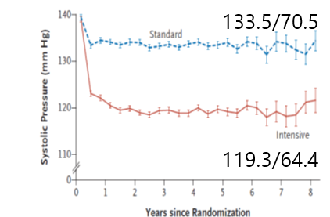
Counterattack by SPRINT trial
139.7
134.6/76.3
121.5/68.7
9,361 individuals with hypertension with high CV risk but not DM or prior stroke, with a baseline SBP ≥130 mmHg, to an intensive-treatment group with a SBP target of <120 mmHg or a standard-treatment group with a SBP target of <140 mmHg
N Engl J Med 2015;373:2103-16
Notes:
The rationale for this change of BP target is based on many observational data and clinical trials.
Above all, it is undeniable that SPRINT trial has provided great supports for these change.
In SPRINT trial, over 9 thousand hypertensive patients~~
In contrast to ACCORD trial, primary outcomes was significantly lower in intensive therapy group and also lower in CV mortality and all-cause of mortality.
These findings were quite different from ACCORD trial.
But, interestingly, achieved BP levels were very similar in both ACCORD and SPRINT trials.

Slide 14
Why did these trials arrive at divergent conclusions?
1. Difference in trial design
- ACCORD used a complex 2 X 2 design(intensive glucose lowering effect?)
2. Difference in population & enrolled criteria
3. Technique for BP measurement
4. Statistical power or chance findings
-The SPRINT trial had a much larger sample size
than ACCORD‑BP (9,361 versus 4,733)
and a higher number of primary outcome events
(562 versus 445).
The average age in SPRINT was higher than in ACCORD‑BP (68 years versus 62 years of age)
Patients with CKD constituted almost 28% of the participants; in ACCORD‑BP, patients with a serum creatinine level higher than 1.5 mg/dl were excluded.
Participants in SPRINT had an average SBP of 139.7 mmHg at baseline and patients with difficult-to‑control BP were excluded.
Notes:
So, why did these trials arrive at divergent results?
Many different things were suggested to explain this discrepancy between two trials such as trial design and difference in population and enrolled criteria and method for blood pressure measurement and difference in sample size and event rate and so on.

Slide 15
Data from SPRINT-eligible ACCORD participants
Diabetes Care 2017;40:1733–1738
Notes:
To evaluate these limitations, many post-hoc analyses were performed,
Among them, I’d like to introduce some studies
This study is a post hoc, subgroup analysis of ACCORD-BP participants.
The purpose of this study is to evaluate whether intensive BP control would be beneficial for T2DM patients who meet the eligibility criteria for SPRINT
They excluded the patients who are not eligible for SPRINT criteria, and then excluded the patients who are participating intensive glucose control arm to eliminate the influence of intensive glycemic control.
Intensive BP control significantly reduced the risk of the SPRINT primary outcome by 21% And also reduced the risk of the ACCORD primary outcome by 31%
Therefore, they suggested that the benefits of intensive BP control manifest most evidently in SPRINT-eligible ACCORD-BP patients who were not receiving intensive glucose control.
If so, is the difference between two trials just made by difference in design and population?

Slide 16
Data from SPRINT-eligible ACCORD participants
We compared SPRINT-eligible ACCORD patients with ACCORD-eligible SPRINT patients by applying the inclusion and exclusion criteria from both trials to each other.
We used stepwise selection to include in the propensity model only variables that were associated with all-cause mortality, which were age, sex, race, number of BP medications taken at baseline, smoking status, history of clinical CVD, history of subclinical CVD, BMI, eGFR, and albuminuria
In a Cox model using all SPRINT and ACCORD patients and controlling for the above predictors of mortality along with an indicator variable for intensive glycemic control, the HRs were 0.71 (95% CI 0.58–0.88) and 1.02 (0.81–1.30), respectively, with a P value for interaction of 0.02.
Our analysis suggests that differences in the demographics and comorbidities between SPRINT and ACCORD do not clearly explain the all-cause mortality benefit for intensive BP control in the former and not the latter.
Diabetes Care 2018;41:e84–e85
Notes:
Interestingly, another group reached a different conclusion in a similar analysis comparing SPRINT and ACCORD trials.
They compared SPRINT-eligible ACCORD patients with ACCORD-eligible SPRINT patients by applying the inclusion and exclusion criteria from both trials to each other and used propensity scoring model
In a result of this analysis, HRs in SPRINT were 0.71 (95% CI 0.58–0.88) and ACCORD were 1.02 (0.81–1.30), respectively, with a P value for interaction of 0.02

Slide 17
Important limitations…
DM vs non-DM
CVD mechanisms and causes of death differ in DM patients compared with the general population.
Microvascular disease (especially kidney disease), accelerated vascular calcification, and diabetic cardiomyopathy are common in DM.
Moreover, the rate of sudden cardiac arrest is markedly increased in DM and related, in part, to diabetes-specific factors other than ischemic heart disease.
Hypoglycemia is a potential cause of CVD mortality that is specific to diabetes.
Diabetic patients are more vulnerable to compromised blood flow to vital organs when BP reaches a critical low point.
DM with CVD vs DM without CVD
Notes:
Even with all these results taken into account, there still is an important limitations
Most of all, diabetic patients are clinically different from non-diabetic patients.
These basic patient characteristics will not be fully justified no matter how statistically endeavored.
And also, these data was performed in the patients with established cardiovascular disease or with high CV risk.
This patients do not represent all diabetic patients that include diabetes without CV risk factors.

Slide 18
Several Meta-analysis
Antihypertensive treatment reduces the risk of
mortality and cardiovascular morbidity in people with
diabetes mellitus and a systolic blood pressure more
than 140 mm Hg. If systolic blood pressure is less than
140 mm Hg, however, further treatment is associated
with an increased risk of cardiovascular death, with no
observed benefit.
Among patients with type 2 diabetes, BP lowering was
associated with improved mortality and other clinical outcomes with lower RRs observed among those with baseline BP of 140mmHg and greater. These findings support the use of medications for BP lowering in these patients.
BMJ 2016;352:i717
JAMA. 2015;313(6):603-615
BP-lowering treatment significantly and importantly reduces cardiovascular risk both in diabetes mellitus and no diabetes mellitus. Contrary to past recommendations, in diabetes mellitus there is little or no further benefit in lowering SBP below 130 mmHg, whereas continuing benefit is seen in no diabetes mellitus also at SBP below 130 mmHg.
Intensive blood pressure lowering provided greater vascular protection than standard regimens. In high-risk patients, there are additional benefits from more intensive blood pressure lowering, including for those
with systolic blood pressure below 140 mmHg. The net absolute benefits of intensive blood pressure lowering in
high-risk individuals are large.
J Hypertens 2017;35:922–944
Lancet 2016;387:435–43
Notes:
Recently, several meta-analysis were performed to evaluate whether intensive systolic blood pressure lowering improve the cardiovascular outcome in diabetic patients.
All meta-analysis conclude that intensive BP lowering treatment significantly reduces CV events both in diabetes and non-diabetic hypertensive patients.
However, there is little or no further benefit in lowering SBP below 130 mmHg in diabetic patients.

Slide 19
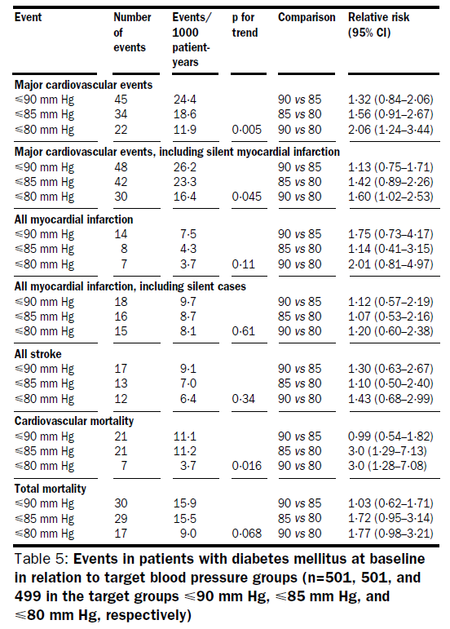
There are no RCTs for diastolic BP target in diabetes
18,790 patients with hypertension were randomly assigned to three DBP targets of ≤90 mmHg, ≤85 mmHg or ≤80 mmHg.
Although no difference between groups was observed in the total study population, a 51% reduction in incidence of cardiovascular events between the ≤80 mmHg and ≤90 mmHg was evident for the subgroup of 1,501 patients with T2DM, in which average achieved BP levels from 6 months of follow‑up to the end of the study were 148/85 mmHg, 146/83 mmHg and 144/81 mmHg for the three BP target groups.
Lancet 351:1755–1762;1998
Notes:
Now let me talk about diastolic BP target for diabetic patients.
There are little or no available clinical evidences supporting a specific DBP target
In HOT trial, over 18 thousands~~
So, diastolic BP target below 80 mmHg might be beneficial for CVD reduction in diabetic patients.
However, actually achieved BP level was 81 mmHg in the target below 80 mmHg group.

Slide 20
Traditional BP target for diabetes
154
144
87
82
UKPDS 38: 1148 hypertensive patients with type 2 diabetes were allocated to comparing tight control of BP aiming at a < 150/85 mm Hg (with the use of captopril or atenolol) with less tight control aiming at a < 180/105 mm Hg.
BMJ 317:703–713;1998
Notes:
This is the UKPDS trial again, where achieved DBP in intensive therapy group was 82 mmHg.
So, there is no direct study that the actual blood pressure reached below 80 mmHg.
Following these trials, better outcomes can be achieved close to the BP level 80 mmHg in general diabetic patients

Slide 21
Diastolic BP in SPRINT and ACCORD trial
139.7
134.6/76.3
121.5/68.7
9,361 individuals with hypertension and increased CV burden but not DM or prior stroke, with a baseline SBP ≥130 mmHg, to an intensive-treatment group with a SBP target of <120 mmHg or a standard-treatment group with a SBP target of <140 mmHg
N Engl J Med 2015;373:2103-16
Notes:
However, in case of ACCORD and SPRINT trials, achieved diastolic BP were below 80 mmHg in both standard and intensive therapy group.
Therefore, we can assume that DBP lowering below 80 mmHg can be safe for the diabetic patients with established CVD or with high CV risk.

Slide 22
Achieved BP at EMPA-REG trial
135.3
The EMPA-REG outcome trial with the impressive reduction in cardiovascular and total mortality in response to empagliflozin indicates that a SBP reduction close to 130 mmHg is safe and might partly explain these beneficial results.
131.3
76.6
75.1
N Engl J Med 2015;373:2117-28
Notes:
And another study we can discuss is EMPA-REG trial.
Although this is not BP targeting trial, SBP reduced close to 130 mmHg and DBP preserved below 80 mmHg in response to empagliflozin.
And this BP reduction to these range can be safe and might partly explain the beneficial effects of intensive BP lowering below 130/80 especially in diabetes with CVD.

Slide 23
Several limitations but…
The SBP goal in intensive group of ACCORD‑BP and SPRINT was <120 mmHg and not <130 mmHg. The mean SBPs that were achieved were 119.3 mmHg and 133.5 mmHg, values that are not even close to 140 mmHg.
There are several differences between two trial, and despite of many attempts for statistical explanation, it can’t be generalized to all diabetic patients.
Nevertheless, a SBP target of < 130 mmHg seems to be justified for certain patients with T2DM especially patients with CVD, but whether the BP target of <130 mmHg in T2DM without high CV risk is justified remained unanswered.
DBP target of <80 mmHg seems to be justified for some patients with T2DM, aside from the data from the HOT and UKPDS trial, both study arms in ACCORD‑BP and SPRINT had DBPs below this level.
Notes:
Overall, there are several limitations

Slide 24
Hypertension Management in Diabetic Patients
1. Measuring blood pressure is recommended at each visit. [B, I]
2. Lifestyle modification in order to achieve normal blood pressure is recommended for diabetic patients with blood pressure >120/80 mmHg. [B, I]
3. Recommended active lifestyle management includes exercise and diet management; reduction in sodium intake, increase in potassium intake, minimized alcohol intake and increasing exercise. [B, I]
4. The target systolic blood pressure in diabetic patients is recommended <140 mmHg. [A, I]
5. The target diastolic blood pressure in diabetic patients is recommended <85 mmHg. [A, I]
6. The target blood pressure for diabetic patients with cardiovascular disease should be considered <130/80 mmHg. [C, IIa]
Notes:
Therefore, on the basis of these evidences, the target blood pressure in diabetic patients is recommended less than 140 and 85 mmHg by Korean diabetes association.
And, the target -------

Slide 25
Treatment Guideline from KSH 2018
Status | Systolic BP | Diastolic BP
Uncomplicated H/T | < 140 | < 90
Old age | < 140 | < 90
Diabetes without CVD with CVD | < 140 < 130 | < 85 < 80
High risk patients | < 130 | < 80
Cardiovascular disease | < 130 | < 80
Cerebrovascular disease | < 140 | < 90
Chronic kidney disease without albuminuria with albuminuria | < 140 < 130 | < 90 < 80
Korean Society of Hypertension 2018
Notes:
Last year, Korean hypertension society published new Hypertension treatment guideline.
In this contents, treatment target for hypertensive patients with diabetes is less than 140/85 and 130/80 in diabetes with CVD patients.
This treatment targets are consistent with the guideline from Korean diabetes association.

Slide 26
Standard Medical Care – ADA 2019
Diabetes Care 2019;42(Suppl. 1):S103–S123
Notes:
If so, how about other guidelines from other countries or societies?
In standard medical care from ADA, BP target differ according to the 10 year ASCV risk.
If existing CVD or 10 year ASCV risk more than 15%, BP target of less than 130/80 mmHg is recommended.
However, diabetic patients with lower risk for CVD(10 year ASCVD risk less than 15%) BP target of less than 140/90 mmHg is recommended.

Slide 27
European Society of Cardiology 2018
European Heart Journal (2018) 39, 3021–3104
Notes:
And this is the guideline from European society of cardiology.
This guideline is quite interesting
Antihypertensive drug…
I think this recommendation is reasonable but is not that simple .

Slide 28
Guidelines from Japan 2019
Hypertension Research (2019) 42:1235–1481
Notes:
Now let's turn our view to the Asian guideline
Japanese Hypertension society set the target BP in diabetic patients as less than 130/80 mmHg
In In this Guidelines, they described that blood pressure control at a lower level is more advantageous in respect to the primary prevention of stroke, which is more frequent in Japanese than in Europe and the United States.

Slide 29
Guidelines from Taiwan 2017
Since stroke is an important CV disease in East Asia, we
recommended an BP target of < 130/80 mmHg for diabetic
patients, using traditional BP measurement.
Acta Cardiol Sin 2017;33:213-225
Notes:
This is the guideline from Taiwan 2017
Taiwan hypertension society also recommended an BP target less than 130/80 mmHg.
In this recommendations, they state that since stroke…

Slide 30
Should the target BP for diabetics be different in the Asian?
Blood pressure and cardiovascular disease in the Asia Pacific region
J Hypertens 2003;21:707-16.
Notes:
should the target blood pressure for diabetics be different in the asian region?
In the Asian region, the association between BP and cardiovascular disease differs, compared to other regions.
In the Asia- Pacific Cohort Studies Collaboration, this study showed a steeper association between SBP and stroke in Asians, compared to an Australasian cohort
Also, stroke was the leading cause of cardiovascular mortality in Asians, whereas ischemic heart disease was the leading cause of mortality in Australasians

Slide 31
BP and development of CVD in Korean diabetic patients
Using the Korean National Health Insurance Service database, 2,262,725 subjects with type 2 diabetes mellitus who underwent regular health checks between 2009 and 2012 were included. Subjects with previous CVDs were excluded.
Hypertension. 2019;73:319-326
Notes:
If so, how about Korean data?
Unfortunately, there are no clinical trials to evaluate BP target in Korean diabetic patients
Recently Dr. MK kim published observational data using National health insurance data.
In this data, Compared with SBP 110 to 119 mmHg, SBP over than 130 mmHg was associated with a significant increase in the incidence of CVDs including stroke and MI
Subjects with diastolic BP 80 to 84 mm Hg had a higher risk of CVDs than subjects with diastolic BP 75 to 79 mm Hg.
There is no difference in blood pressure level for risk of stroke and ischemic heart disease
And, they concluded that the optimal cutoff for Korean diabetic patients may be less than 130/80 mm Hg.
However, this is just observational study, so clinical trial for Korean BP target is needed to set our own target goal.

Slide 32
Treatment target goal of hypertension in diabetes
The target blood pressure < 130/80 mmHg seems to be justified for diabetic patients with CVD.
Since most trials have been conducted on hypertensive patients with CVD or high risk, it can’t be generalized to all diabetic patients.
The target blood pressure in general diabetic patients(especially without CVD) is recommended <140/85 mmHg.
For patients with diabetes and hypertension, BP targets should be individualized through a shared decision making process that addresses CV risk, potential adverse effects of antihypertensive medications, and patient preferences.
Further studies are needed to evaluate the appropriate BP target in diabetic patients with hypertension, especially in Asian diabetic patients including Korean.
Notes:
All together, it seems that we are living in an age of uncertainty when it comes to hypertension.
There are still many debate and limitations, but we can summarize them as the following.

Slide 33
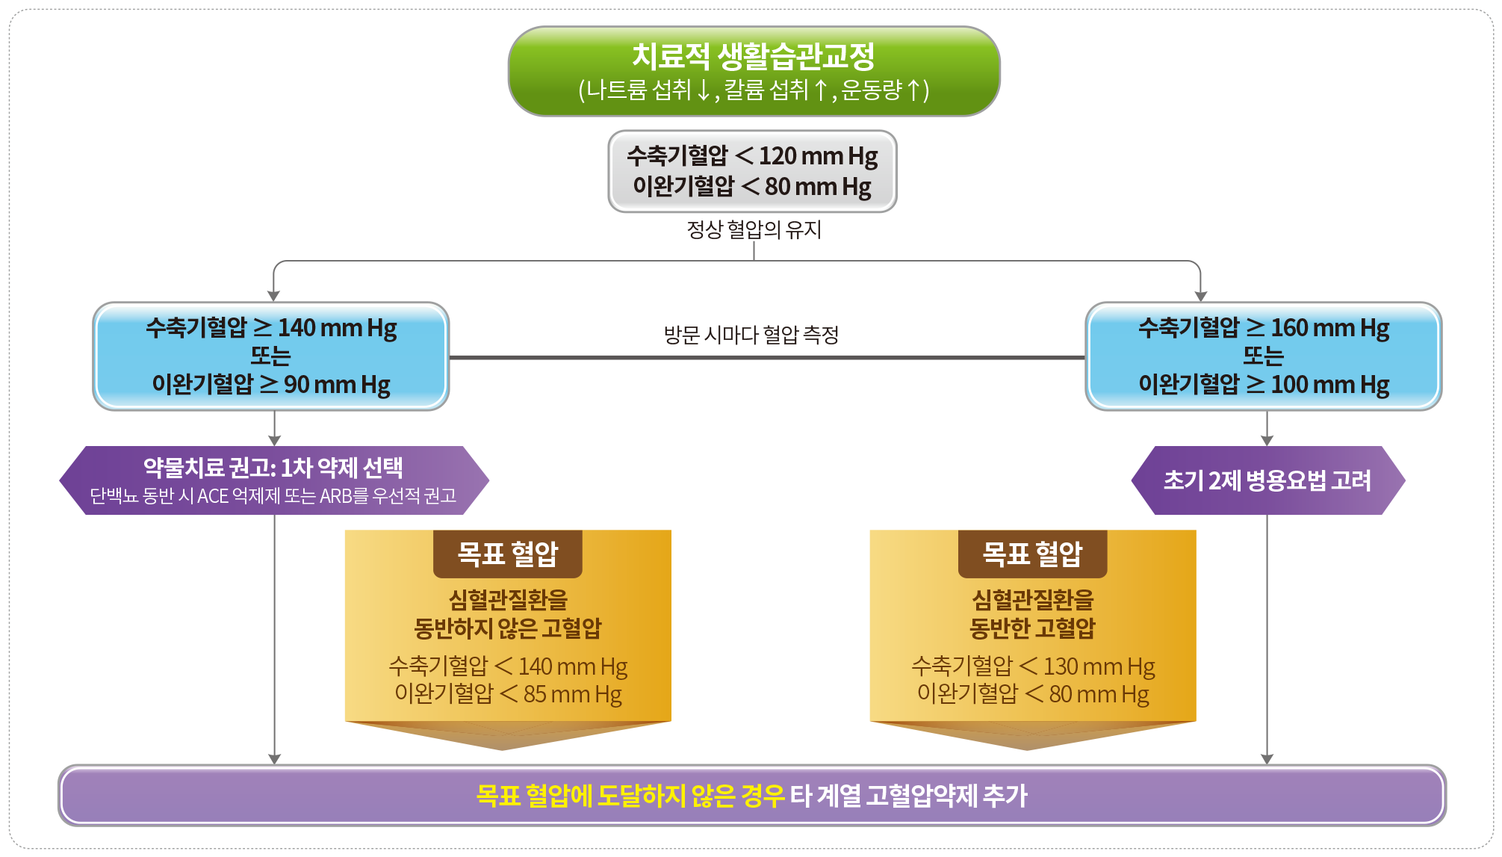
Algorithm for Hypertension Management in Diabetic Patients
Lifestyle modification
(Na↓, K↑, Exercise↑)
SBP < 120 mmHg
DBP < 80 mmHg
SBP ≥ 140 mmHg
Or
DBP ≥ 90 mmHg
SBP ≥ 160 mmHg
Or
DBP ≥ 100 mmHg
BP check per each visit
Recommend Drug therapy
RAS blocker if proteinuria(+)
Consider initial
combination therapy
Target BP
H/T without CVD
SBP < 140 mmHg
DBP < 85 mmHg
Target BP
H/T with CVD
SBP < 130 mmHg
DBP < 80 mmHg
Add another BP-lowering agent if target is not meet
Notes:
This is the final slide of this talk.
Algorithm for hypertension management from KDA guideline.
Although this guidelines do not clarify everything, I hope that this would be of little help in your actual clinical practice

Slide 34
Thanks for your attention!
Sang Yong Kim
Division of Endocrinology and Metabolism,
School of Medicine, Chosun University

